Slide 1


Slide 2


Slide 3
High performance team activity

Slide 4
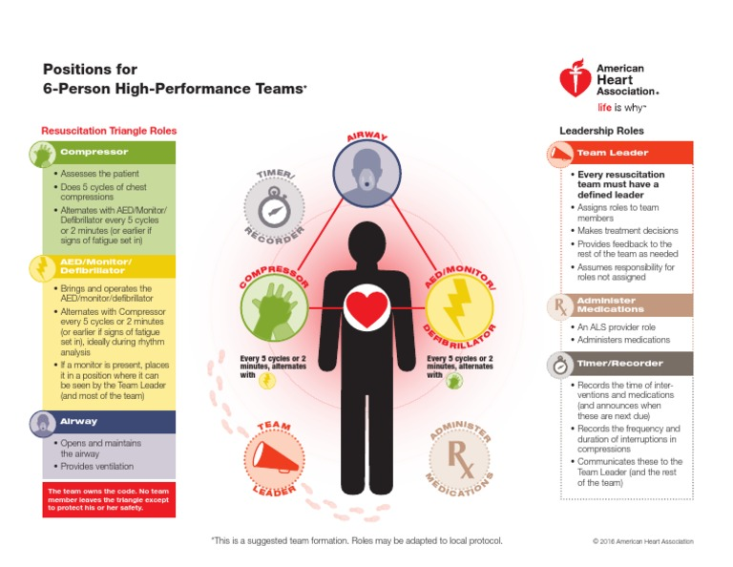

Slide 5
The goal is to perform high quality CPR pushing upto atleast 2 inches,
atleast 100 to 120 compressions per minute allowing full recoil of
chest and no excessive ventilation.
It is very important the team is on the same page co-ordinating the work and preventing confusion

Slide 6
One person is given the position of team leader who assign the different roles to the other personnel
Immediately when the team reaches the site, one person to go check for pulse and take over chest compressions from the bystander
One person to take care of airway
Once AED is available,one person attach he pads to the body of the patient. It will analyse the rhythm.

Slide 7
If it’s a shockable rhythm others should remove hands from the patient and stay clear when the shock is delivered.
If its non shockable rhythm continue with the chest compressions
Once the shock is delivered continue with the chest compressions and ventilation

Slide 8
It is important each personnel know their role.
It is important to have a proper communication between the team mates
If a team leader finds a personnel not doing a work efficiently its important to correct it.

Slide 9
If you feel the chest compressions are not efficient ask the personnel to push harder and faster in a polite way.
If a personnel feel they are tired and feel difficulty in doing a work it is important for them to come forward and ask for help.
In a case where a health personnel feels tired after giving chest compressions other person can take over so the quality of the CPR
doesn’t get compromised.

Slide 10
It is important to make sure the timing is maintained and switch between compressions every 2 min
One personnel can ask the bystander the details of the incident

